Slide 1


Cascade analysis and use of data in Zimbabwe
Monitoring the 3 90’s, The Next Frontier: From Surveys to Routine Data to Build Cascade Monitoring at Local Level
Regis C Choto [MBChB, MPH (uz)]
National ART Coordinator
Ministry of Health and Child Care, Zimbabwe
WHO Satellite Session, IAS 2018 Amsterdam, Netherlands
27 July 2018
NO CONFLICT OF INTEREST, NO DISCLOSURES

Slide 2
Presentation Outline
Country Profile & HIV Epidemiology
What progress has been made in application of routine data in the HIV response?
Extent of integration with other information systems & how local data is being used?
Success and challenges in implementation
Priority Actions & Next plans to enhance HMIS

Slide 3
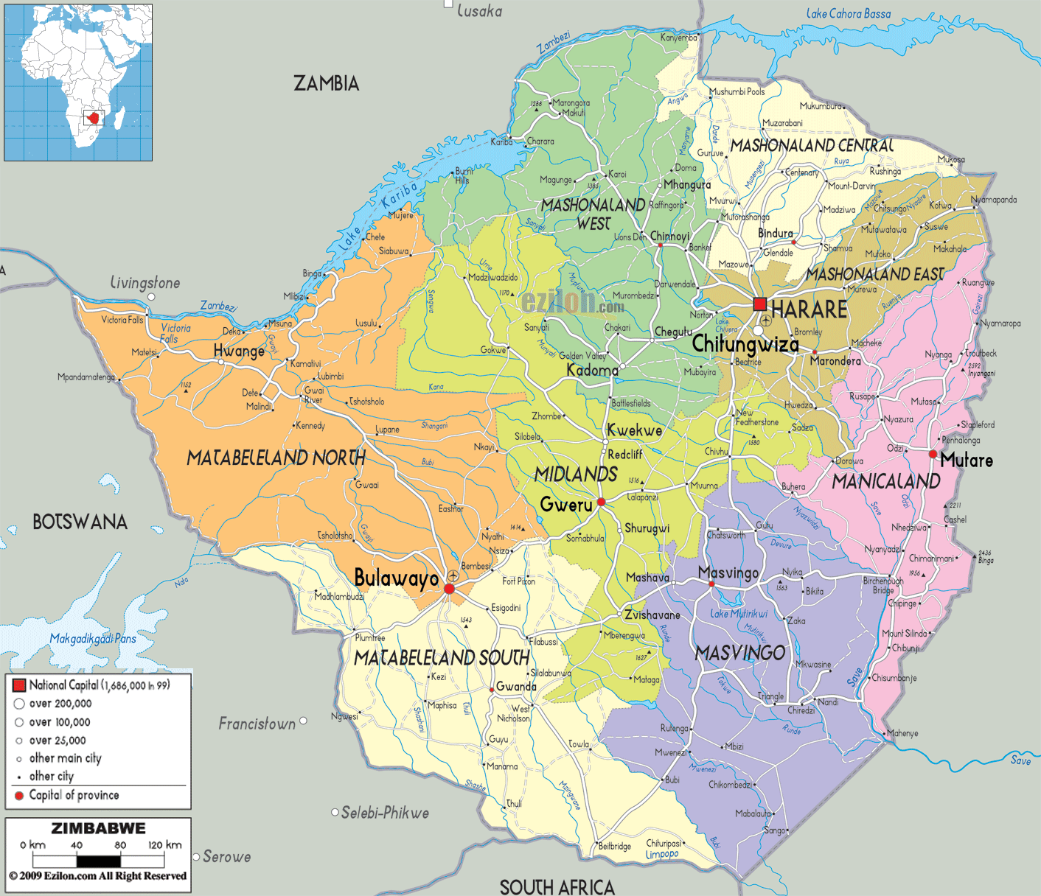
Country Profile
Total Popn ~ 13 million [2012 Census]
Zimbabwe is a landlocked country in SSA
Expenditure on health as % Gross Domestic Product of 6.4% [Public Expenditure Review – PER – 2015]
Maternal & <5yr child mortality rates of 614 deaths/100,000 live births & 75 deaths/1,000 live births respectively [MICS, 2014]
Country heavily burdened by HIV/AIDS and TB
  1.4M PLHIV (incl. 7% children);
  HIV Incidence & Prevalence of 0.48% & 13.8% respectively [ZIMPHIA, 2016, MOHCC HIV Estimates 2017]
  TB prevalence of 314/100,000 popn [TB Prevalence Survey, 2015]
As at end Dec 2017, a total 1,119,909 people on ART (incl 68,119 children, 0-14yrs) [MOHCC, 2018]
Notes:
Zimbabwe has a projected population of 13m people and is among the countries in Sub-Saharan
Africa worst affected by the HIV

Slide 4
Despite significant milestones having been achieved and country on track towards meeting 90 90 90 targets before 2020, gaps still exists….
Biggest gap remains on first 90 which is still 74,2%
Variations in achieving 90 90 90 still noted by geographic area & different target population groups
Country adapted use of cascades at all levels from the 2015 WHO SI guidelines as a key monitoring strategy for achieving 90-90-90 global HIV targets
Source: ZIMPHIA, 2016

Slide 5
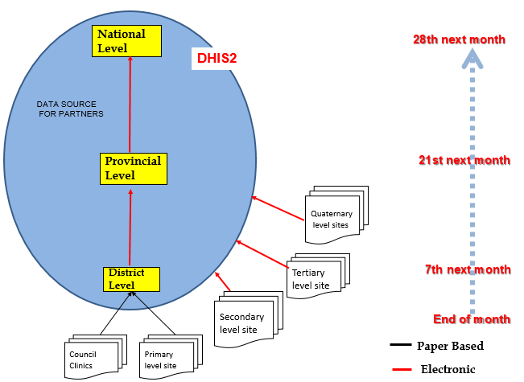
Zimbabwe’s Health Information Management System (Background)
Systems and structures in place for planning & coordination of M&E
  Comprehensive costed national M&E plan in place complemented by indicator guides, job aides, SOPs etc
  M&E Department headed by a Director in place which provides oversight to all M&E issues under each disease programme at national, provincial and district levels
  Vibrant M&E subcommittee in place with strong partner representation for broad based technical consultations and financial support
Data collection/reporting systems at primary health care level predominantly manual & paper based with a web-based Health Information System (DHIS2) available from district level which facilitates electronic data upload and analysis
Data flow between different levels of care in the MoHCC
Source: MOHCC M&E Strategy, 2015 - 2020

Slide 6
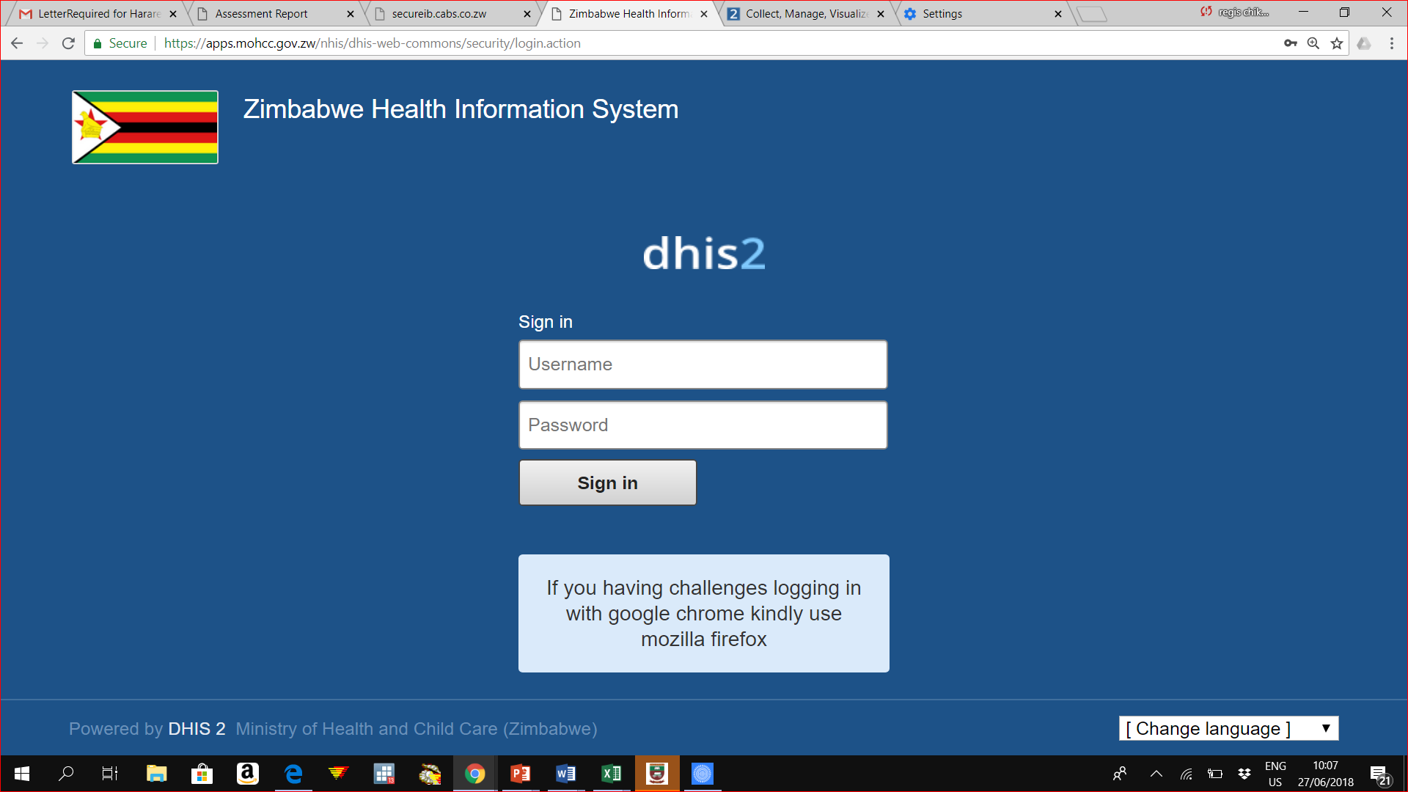
Evolution of Zimbabwean HMIS/DHIS2 system
2011
2012
2013
DHIS1.4
Desktop based application pioneered by HISP SA & adapted by Zimbabwe
DHIS2.0 pilot
Piloted in one province
DHIS2.0
Roll Out
Rolled out to all country’s 63 districts
Associated with many challenges i.e. malfunctioning due to viruses, non scalability
Associated with many advantages & subsequently adapted
T – series, Malaria, HIV, RMNCH, TB, nutrition modules added
Timeliness & completeness improved from <70% to > 90%
Community module being dvlped

Slide 7
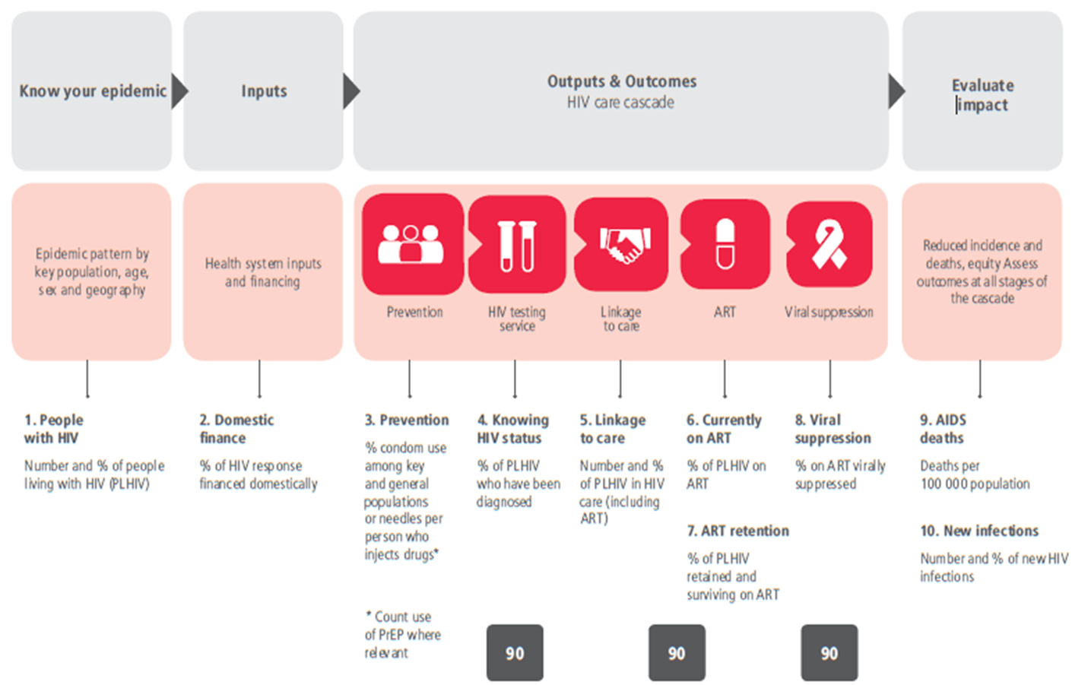
Roll out of electronic patient level systems to facilitate longitudinal tracking of HIV clients …
Due to increased workload & need to meet HIV reporting commitments (nationally and internationally)
  Country adapted Electronic Patient Monitoring System (ePMS) from Tanzanian’s CTC system in 2012
  By 2017, ePMS in 534 high volume solar-powered sites with more than 800,000 HIV positive cases in system
HIV prevention (HTS and VMMC) and case notification modules have been developed and currently under pilot
System also longitudinally tracks pregnant and lactating women and HIV Exposed Infants
Local Area Network/Wide Area Network installed & Macro database developed with support from Global Fund to link all ePMS sites for de-duplication & ease of data analysis and reporting
Source: Adopted from the 2015 WHO Strategic Information Guidelines

Slide 8
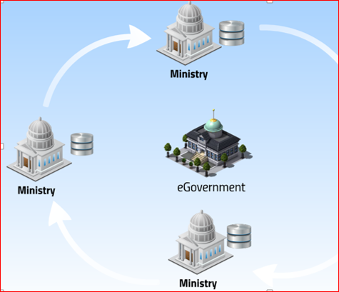
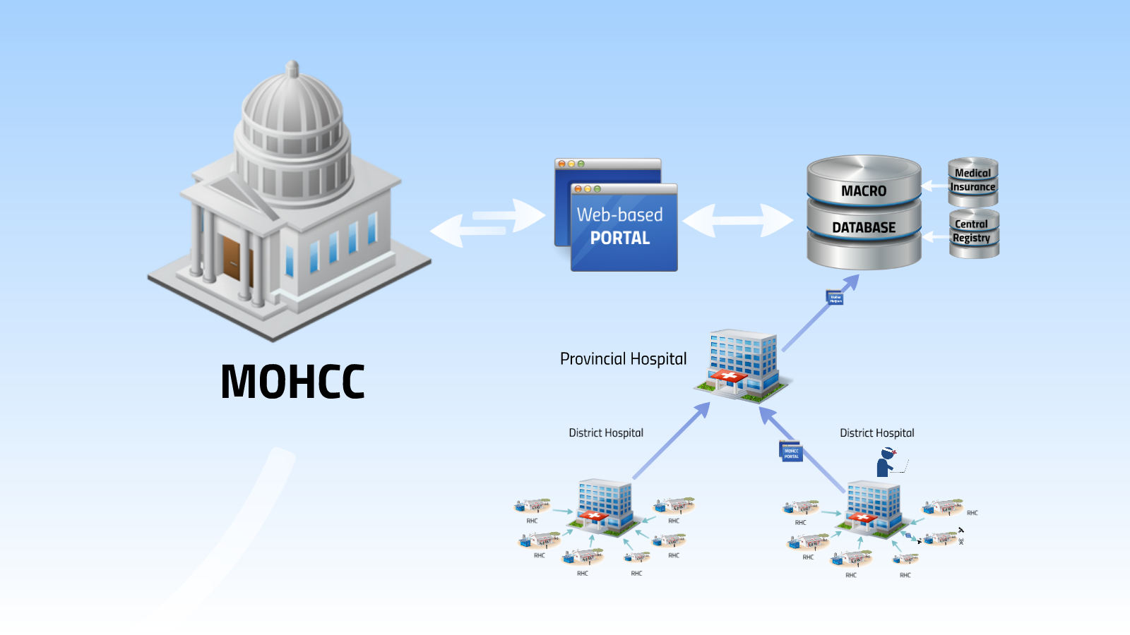
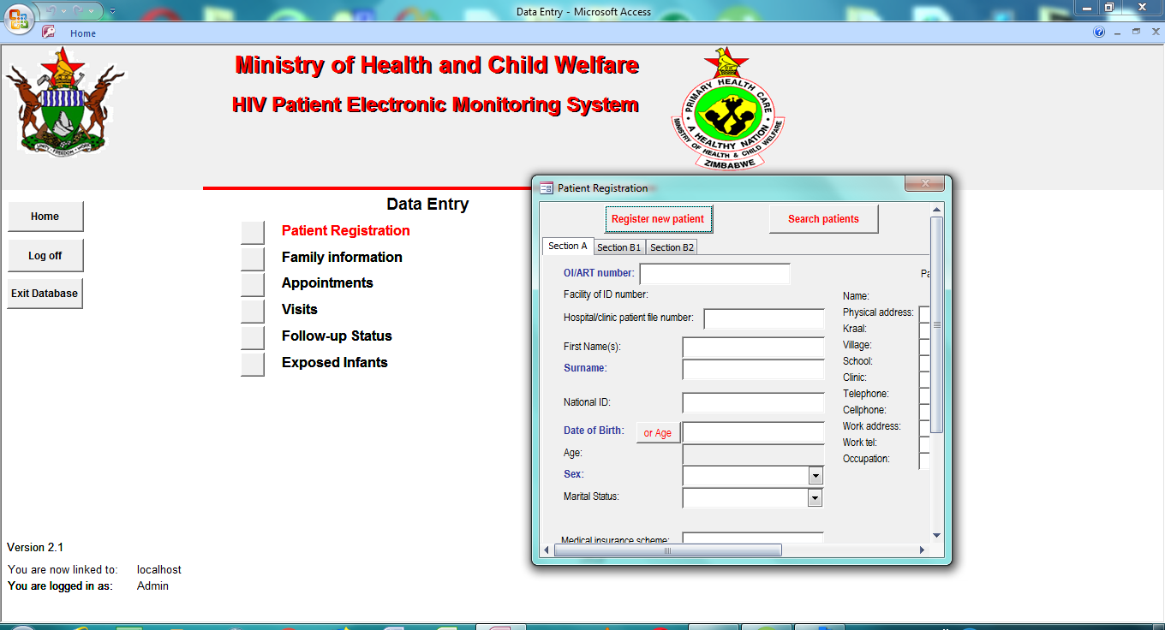

Integration with other information systems & other diseases programs in context of UHC
EHR
HIV Module
Source: MOHCC, 2017

Slide 9
National Progress Towards Meeting 90-90-90 Targets as at Dec 2017
74%
84%
88%
1st 90
2nd 90
3rd 90
Source: MOHCC Programme Data, 2018; DHS 2015/16; MOHCC 2017 HIV estimates, ZIMPHIA 2016

Slide 10

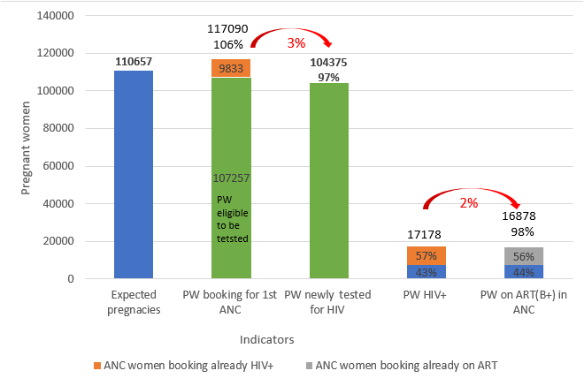
Missed Opportunities in the National PMTCT Care Cascade…..
National PMTCT Care Cascade, Jan - Mar 2018

Slide 11
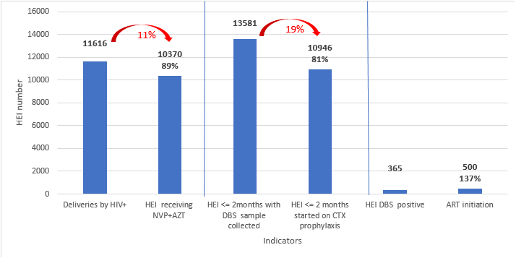
Missed Opportunities in the National HIV Exposed Infant Care Cascade…
National HIV Exposed Infant Cascade, Jan - Mar 2018

Slide 12

Missed Opportunities in National HIV Testing Services Cascade, Jan – Mar 2018
Adoption of innovative integrated HTS approaches to improve linkages to care & yield
- Index case testing
- HIV Self Testing (HTS)
- Moonlight HTS
- Family centred approaches (FCA)
- Targeted PITC
6%
1%
18%
Source: MOHCC, 2018

Slide 13
Variations along the HIV Treatment & Care Cascade across Provinces…
ART Initiation Cascades by Province, Jan-Mar 2018
Source: MOHCC, 2018
Notes:
Midlands province,Mashonaland West,Mashonaland East & Central and Harare had the highest number of PLHIV newly diagnosed not linked for OI/ART services and enrolled into care.
The newly enrolled into care were higher than those linked for care in Midlands,Matabeleland South and North,Mashonaland East and Harare provinces.

Slide 14
Variations in HIV Testing Services Cascades across districts ….
District HIV Testing Services Cascade, Jan - Mar 2018

Slide 15
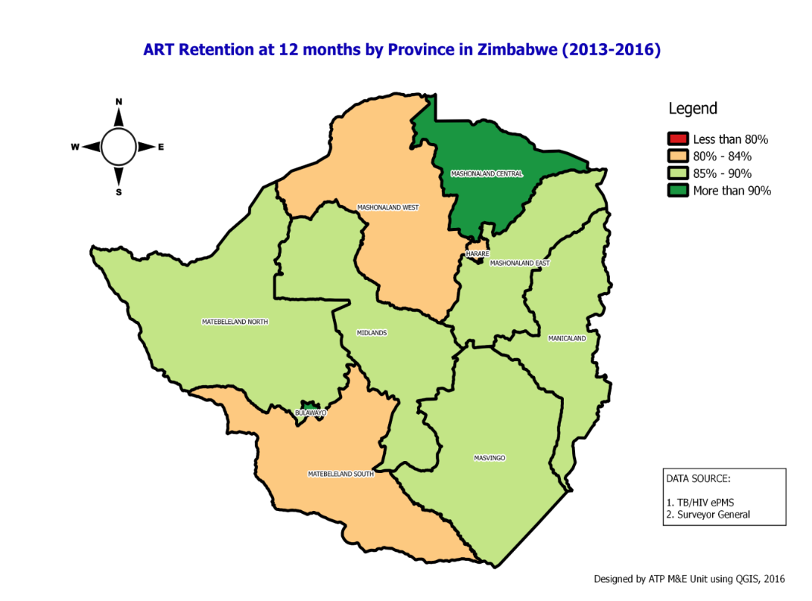
With roll out of ePMS, routine tracking of ART retention rates among clients on ART now possible & being implemented periodically ….
Patient retention over time by sex
Source: Zimbabwe MOHCC (ePMS), 2016

Slide 16
With Roll Out of ePMS routine Implementation of Quality Improvement Initiatives Enhanced...
Quality Improvement Initiatives Performance Data – PMTCT Indicators (Jul 2015 – Dec 2016)
Causes for gaps:
  We don’t know what to do
  We know what to do but we don’t do it
  We know what to do, we do it, but we don’t document it
Goal: We know what to do, we do it, we document it

Slide 17
Despite significant progress made in strengthening country’s HIMS, weaknesses still exists in optimizing facility data use & analysis….
 | Comprehensive costed multi-year M&E plan in place with strong MOH leadership | HIMS / specific program SOPs in place & being used | Core set indicators generation | Data Quality Checks and Audits being done using standardized methods | Strong data analytical capacity of HF based statistics | Periodic generation of progress and performance reports | Periodic feedbacks given | Data sharing with users
HMIS | M&E plan in place with some aspects being implemented | SOPs in place though with some gaps in use | Some core indicators available but needs updating | Regular Data Quality checks at district & national levels and sometimes independent OSDVs | Good analytical capacity for core indicators generated and use of data from multiple sources | Regular analytical reports produced showing progress and performance against targets at national level | Little local use of health facility data | Users can request password from MOH and more than 25 persons outside ministry currently have access
HIV | M&E plan in place with some aspects being implemented | SOPs in place though with some gaps in use | Core set of indicators generated but last updated in 2015-2016 | Regular Data Quality Checks at all levels using standardized methods with annual independent OSDVs | Strong analytical capacity of HF based statistics including triangulation with other data and estimates | Regular analytical reports produced showing progress and performance against targets at national level | Districts have regular good quality reports and score cards of progress and performance against set targets | Users can request password from MOH and more than 25 persons outside ministry currently have access

Slide 18
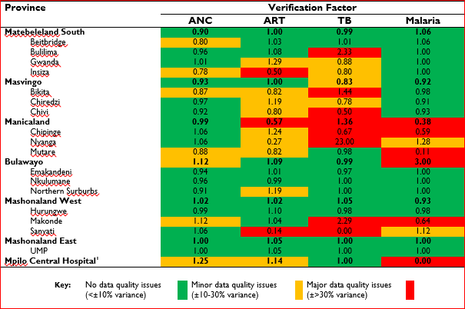
Over-reporting & underreporting on some key indicators across disease programmes still happening due to manual based M&E recording & reporting systems…………………..
Verification Factor by Indicator per Province/District, Jul – Dec 2016
Source: National Routine Data Quality Review and Assessment for HIV, TB, MNCH and Malaria in Zimbabwe, 2017

Slide 19
To achieve universal health coverage, country to take a ‘business unusual approach’ to enhance HMIS or DHIS2 use & analysis at local level
Existing Gap | Proposed Priority Actions to Address Current Main Gaps
DHIS2.0 version in place and set of core indicators for key areas in use outdated and need updating/upgrading | Updating the existing DHIS2 version and revise core indicators & standardisation of data elements aligning with 2017 WHO guidelines
Limited local capacity to use health facility data and statistics to inform programming & feedback | Capacity building of healthcare workers in data collection, analysis and use at all levels through mentorships & trainings MoHCC institutionalizing results based funding (RBF) to include all priority indicators reported through the DHIS2 and data quality issues Institutionalize Routine Data Quality Audits (DQAs) and On-Site Data Verification Exercises (OSDVs) Integration of ePMS & DHIS2 to mitigate transcription & arithmetic errors
Poor data quality across most indicators collected through the DHIS2 which results in underreporting and over reporting on priority indicators

Slide 20

Thank You & Acknowledgements
All levels of health care delivery systems
NAC
Global Fund
PEPFAR
USAID and CDC
UN Family (WHO, UNDP, UNFPA, UNICEF, UNAIDS, WFP)
PSI, ITECH, OPHID, ZAZIC, CHAI, PANGEA , FHI 360, CHEMONICS, EGPAF, ZNFPC
DREAMS partners
Civil Society and communities at large
PLHIV

